Slide 1
Ethical issues in consumer data
Which protections should exist in the application of Artificial Intelligence to consumer spending data?

Slide 2
Consumer spending data can be used and misused
Ethical issue
Use for good
Misuse of data
Spending data
Individual spending data collected on consumers can be used to enhance consumer value or used in ways which may act against the consumer.
Benefits the consumer
AI in fraud detection
Budgeting advice
Financial product recommendations to achieve goals
Unintended consent
Onward sale of data
Privacy breach
Credit surveillance and scoring
Government/police use for surveillance

Slide 3
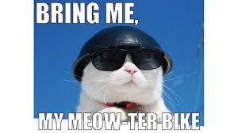
Example use case for good
Enhance consumer value/lifestyle
Consumer subscribers to Superbikes magazine
Consumer does not spend at petrol stations
Consumer make no payments to a vehicle plan at present
Third-party (e.g. Honda UK Ltd) launches a new motorcycle financing offer with attractive terms for creditworthy customers
AI determines the customer could be interested in purchasing a new bike; does not have an existing vehicle; can afford to make regular payments; may be interested in purchasing a bike; so informs the customer of the new deal from Honda.
Customer was not aware of the Honda offer before the AI bot suggestion, and does like that brand, so makes the purchase.

Slide 4
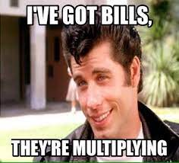
Example use misuse
Acting for the benefit of the data-holder or a third-party
AI model detects stress in the customer spending behaviour, including increasing usage of overdraft and credit card limits
Bank informs mortgage lender of higher customer risk profile, perhaps in return for a fee from the lender.
Mortgage lender seeks further security from the customer e.g. suggests they take out mortgage payment protection insurance.

Slide 5
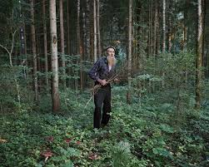
Solution:
Live “off the grid”

Slide 6
Solution:
Consumer-awareness campaigns
Coordination between stakeholders: govt; industry; consumer welfare groups.
International agreements on AI transparency standards.
Enhance transparency and a establish a common set of ethical standards.

Slide 7
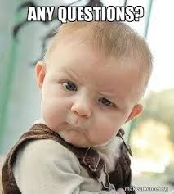
Questions?
hmmm?

